Slide 1
HADOOP
Presentation By Shubham Choudhary

Slide 2
HADOOP
Apache Hadoop is an open source framework that is used to efficiently store and process large datasets ranging in size from gigabytes to petabytes of data. Instead of using one large computer to store and process the data, Hadoop allows clustering multiple computers to analyze massive datasets in parallel more quickly.
Hadoop consists of four main modules:
Hadoop Distributed File System (HDFS) – A distributed file system that runs on standard or low-end hardware. HDFS provides better data throughput than traditional file systems, in addition to high fault tolerance and native support of large datasets.
Yet Another Resource Negotiator (YARN) – Manages and monitors cluster nodes and resource usage. It schedules jobs and tasks.
MapReduce – A framework that helps programs do the parallel computation on data. The map task takes input data and converts it into a dataset that can be computed in key value pairs. The output of the map task is consumed by reduce tasks to aggregate output and provide the desired result.
Hadoop Common – Provides common Java libraries that can be used across all modules.

Slide 3
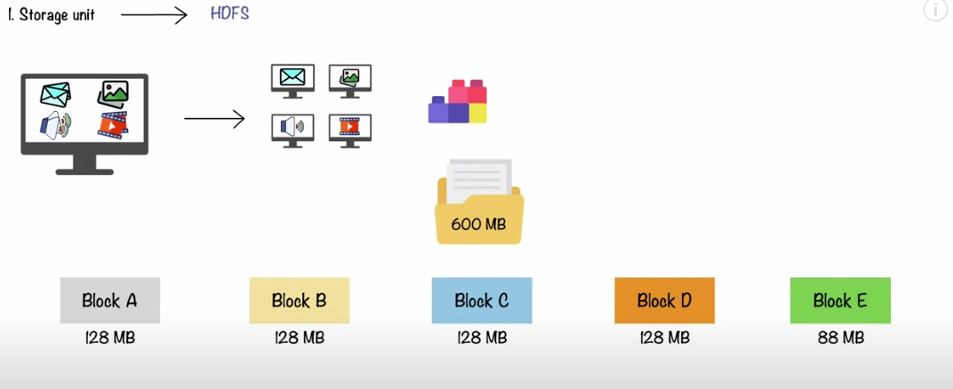

Slide 4
What is Hadoop?
Hadoop is an open source software utilities collection to perform computations on massive amount of data. Hadoop provides a software framework for multiple storage in different locations and process them using MapReduce technology. Hadoop processes various structured and unstructured to collect, process and analyze big data. There are several advantages and disadvantages of using Hadoop, understanding them will help your cause.
Advantages of Hadoop:
1. Scalable
Hadoop is a highly scalable storage platform, because it can stores and distribute very large data sets across hundreds of inexpensive servers that operate in parallel. Unlike traditional relational database systems (RDBMS) that can’t scale to process large amounts of data, Hadoop enables businesses to run applications on thousands of nodes involving many thousands of terabytes of data.
2. Cost effective
Hadoop also offers a cost effective storage solution for businesses’ exploding data sets. The problem with traditional relational database management systems is that it is extremely cost prohibitive to scale to such a degree in order to process such massive volumes of data. In an effort to reduce costs, many companies in the past would have had to down-sample data and classify it based on certain assumptions as to which data was the most valuable. The raw data would be deleted, as it would be too cost-prohibitive to keep. While this approach may have worked in the short term, this meant that when business priorities changed, the complete raw data set was not available, as it was too expensive to store.

Slide 5
3. Flexible
Hadoop enables businesses to easily access new data sources and tap into different types of data (both structured and unstructured) to generate value from that data. This means businesses can use Hadoop to derive valuable business insights from data sources such as social media, email conversations. Hadoop can be used for a wide variety of purposes, such as log processing, recommendation systems, data warehousing, market campaign analysis and fraud detection.
4. Fast
Hadoop’s unique storage method is based on a distributed file system that basically ‘maps’ data wherever it is located on a cluster. The tools for data processing are often on the same servers where the data is located, resulting in much faster data processing. If you’re dealing with large volumes of unstructured data, Hadoop is able to efficiently process terabytes of data in just minutes, and petabytes in hours.
5. Resilient to failure
A key advantage of using Hadoop is its fault tolerance. When data is sent to an individual node, that data is also replicated to other nodes in the cluster, which means that in the event of failure, there is another copy available for use.

Slide 6
Disadvantages of Hadoop:
As the backbone of so many implementations, Hadoop is almost synomous with big data.
1. Security Concerns
Just managing a complex applications such as Hadoop can be challenging. A simple example can be seen in the Hadoop security model, which is disabled by default due to sheer complexity. If whoever managing the platform lacks of know how to enable it, your data could be at huge risk. Hadoop is also missing encryption at the storage and network levels, which is a major selling point for government agencies and others that prefer to keep their data under wraps.
2. Vulnerable By Nature
Speaking of security, the very makeup of Hadoop makes running it a risky proposition. The framework is written almost entirely in Java, one of the most widely used yet controversial programming languages in existence. Java has been heavily exploited by cybercriminals and as a result, implicated in numerous security breaches.
3. Not Fit for Small Data
While big data is not exclusively made for big businesses, not all big data platforms are suited for small data needs. Unfortunately, Hadoop happens to be one of them. Due to its high capacity design, the Hadoop Distributed File System, lacks the ability to efficiently support the random reading of small files. As a result, it is not recommended for organizations with small quantities of data.

Slide 7
4. Potential Stability Issues
Like all open source software, Hadoop has had its fair share of stability issues. To avoid these issues, organizations are strongly recommended to make sure they are running the latest stable version, or run it under a third-party vendor equipped to handle such problems.
5. General Limitations
The article introduces Apache Flume, MillWheel, and Google’s own Cloud Dataflow as possible solutions. What each of these platforms have in common is the ability to improve the efficiency and reliability of data collection, aggregation, and integration. The main point the article stresses is that companies could be missing out on big benefits by using Hadoop alone.

Slide 8
Running Hadoop on AWS
Amazon EMR is a managed service that lets you process and analyze large datasets using the latest versions of big data processing frameworks such as Apache Hadoop, Spark, HBase, and Presto on fully customizable clusters.
Easy to use: You can launch an Amazon EMR cluster in minutes. You don’t need to worry about node provisioning, cluster setup, Hadoop configuration, or cluster tuning.
Low cost: Amazon EMR pricing is simple and predictable: You pay an hourly rate for every instance hour you use and you can leverage Spot Instances for greater savings.
Elastic: With Amazon EMR, you can provision one, hundreds, or thousands of compute instances to process data at any scale.
Transient: You can use EMRFS to run clusters on-demand based on HDFS data stored persistently in Amazon S3. As jobs finish, you can shut down a cluster and have the data saved in Amazon S3. You pay only for the compute time that the cluster is running.
Secure: Amazon EMR uses all common security characteristics of AWS services:
Identity and Access Management (IAM) roles and policies to manage permissions.
Encryption in-transit and at-rest to help you protect your data and meet compliance standards, such as HIPAA.
Security groups to control inbound and outbound network traffic to your cluster nodes.
AWS CloudTrail: Audit all Amazon EMR PI calls made in your account to provide security analysis, resource change tracking, and compliance auditing.

Slide 9
Configuring AWS Hadoop
AWS EC2 Startup
Select Instance
Instance Type
Instance Details
Storage
Instance Tags
Security Group
Launch Instances
Naming the Instances
Setting Up Instances
Copy Instance Public DNS Name
Common Setup on All Nodes
All Nodes: Install Java
All Nodes: Install Apache Hadoop
All Nodes: Setup JAVA_HOME
All Nodes: Update core_site.xml
All Nodes: Create Data Dir

Slide 10
Configuring NameNode
Namenode: Password Less SSH
Datanodes: Setup Public Key
Namenode: Setup SSH Config
Namenode: Setup HDFS Properties
Namenode: Setup MapReduce Properties
Namenode: Setup YARN Properties
Namenode: Setup Master and Slaves
Configuring Data Nodes
Starting the Hadoop Cluster
Check the Web UI
Summary

Slide 11
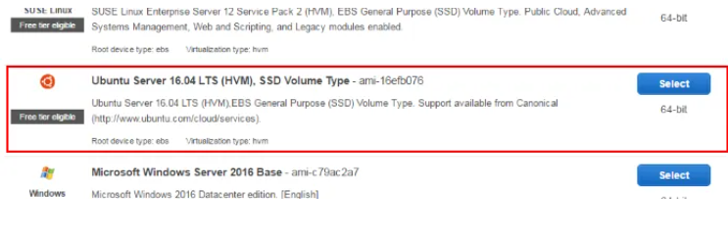
Steps:
1) AWS EC2 Startup
We will now create 4 instances of Ubuntu Server 16.04 LTS using Amazon EC2.
2) Select Instance
Go to your AWS Console, Click on Launch Instance and select Ubuntu Server 16.04 LTS

Slide 12
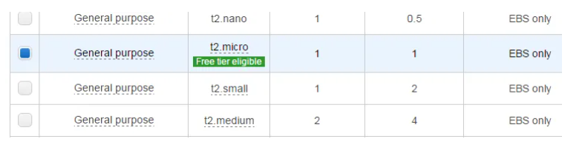
3)Instance Type
For the instance type, we choose t2.micro since that is sufficient for the purposes of the demo. If you have a need for a high-memory or high-cpu instance, you can select one of those.

Slide 13
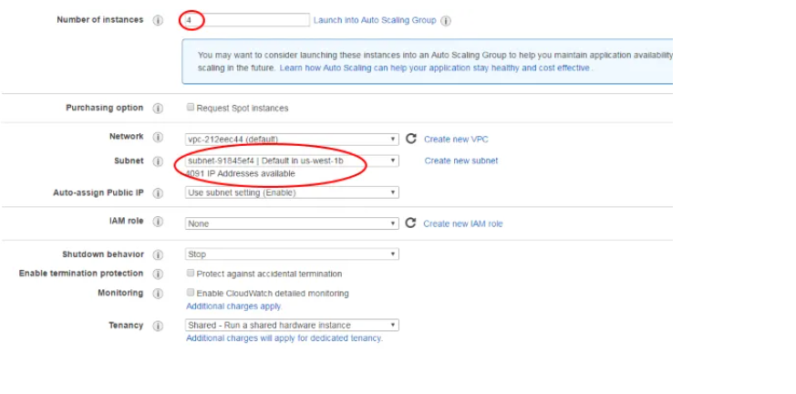
Click Next to Configure Instance Details
4) Instance Details
Here, we request 4 instances of the selected machine type. We also choose a subnet (us-west-1b) just so we can launch into the same location if we need more machines.

Slide 14
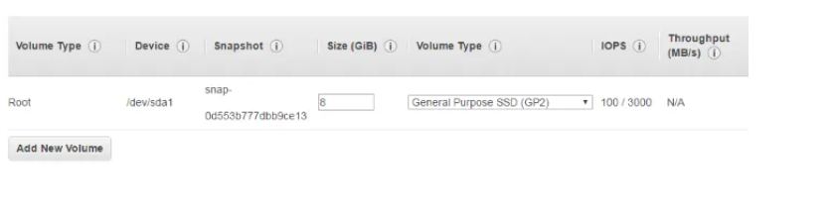
Click Next to Add Storage
5) Storage
For our purpose, the default instance storage of 8GB is sufficient. If you need more storage, either increase the size or attach a disk by clicking “Add Volume”. If you add a volume, you will need to attach the volume to your instance, format it and mount it. Since this is a beginner tutorial, these steps are not covered here.

Slide 15
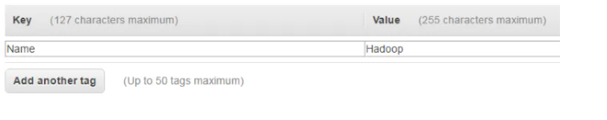
Click Next to Add Tags to your instances.
6) Instance Tags
A tag allows you to identify your instance with a name you can choose
Click Add Tag, set the Key to “Name” and value to “Hadoop”. We will use this tag to re-label our instances as “namenode”, “datanode1” and so on later on. For now leave the value of all the instances as “Hadoop”.

Slide 16
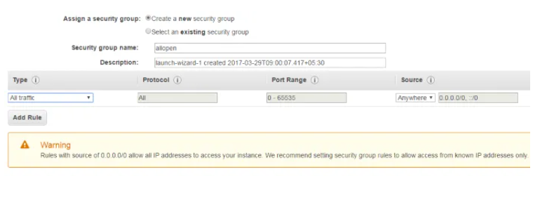
Click Next to configure Security Group for the instances.
7) Security Group
For the security group, we create a completely open security group for the purposes of testing.

Slide 17
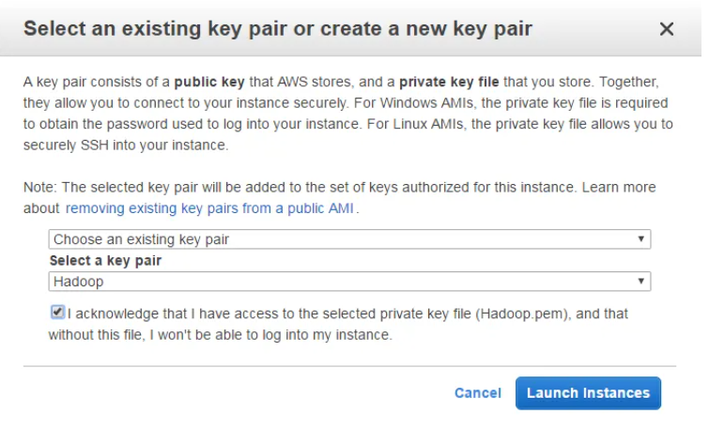
Finally we get to the Launch screen
8) Launch Instances
Review the information again and click Launch to start the instances. You will need to create a key pair or use an existing key pair. Follow the instructions on the Launch Wizard to create a new key pair. Then click “I acknowledge ..” and then Launch Instances.

Slide 18
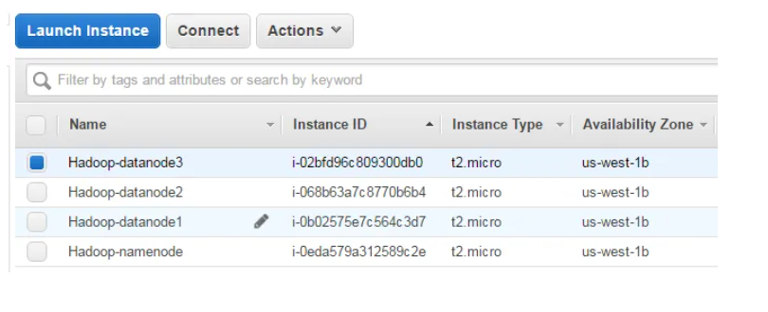
You can now go to the instances page and check on the status of the instances.
9)Naming the Instances
On the instances page, let us setup the names of the instances. These are not DNS names, but names we assign to help us distinguish between them.
Click the pencil icon next to the name and setup the names as shown.

Slide 19
10) Setting Up Instances
Once the instances are up and running, it is time to set them up for our purpose. This includes the following:
Setup password-less login between the namenode and the datanodes.
Install java.
Setup Hadoop.
11) Copy Instance Public DNS Name
We now need to copy the Public DNS Name of each node (1 namenode and 3 datanodes). These names are used in the configuration steps below. Since the DNS is specific to each setup, we refer to the names as follows.
For example, in the description below, if you see <nnode>, substitute with the value of <NameNode Public DNS>. Similarly for <dnode1> and so on.
nnode | <NameNode Public DNS>
dnode1 | <DataNode1 Public DNS>
dnode2 | <DataNode2 Public DNS>
dnode3 | <DataNode3 Public DNS>

Slide 20
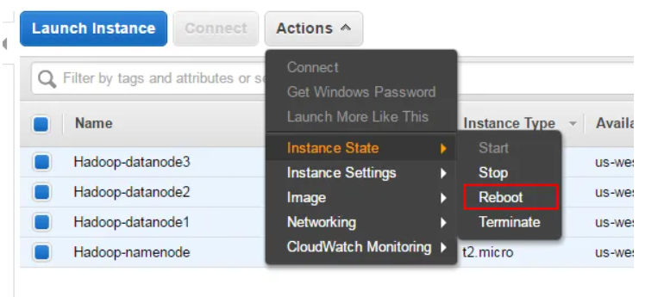
12)Common Setup on All Nodes
Some setup is common to all the nodes: NameNode and DataNodes. This is covered in this section.
13) All Nodes: Update the instance
Let us update the OS with latest available software patches.
After the updates, the system might require a restart. Perform a Reboot from the EC2 Instances page.

Slide 21
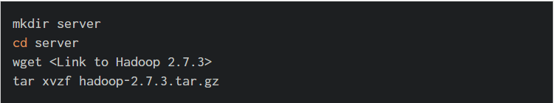
All Nodes: Install Java
Let us now install Java. We install the package: openjdk-8-jdk-headless on all the nodes.
All Nodes: Install Apache Hadoop
Install Apache Hadoop 2.7.3 on all the instances. Obtain the link to download from the Apache website and run the following commands. We install Hadoop under a directory server in the home directory.

Slide 22
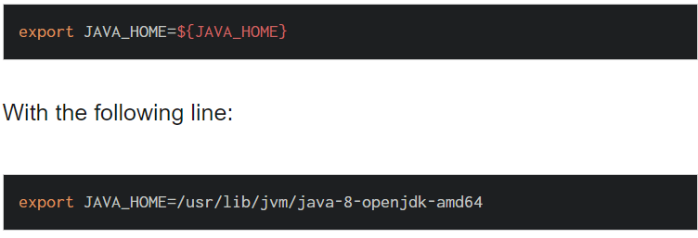
All Nodes: Setup JAVA_HOME
On each of the nodes, edit ~/server/hadoop-2.7.3/etc/hadoop/hadoop-env.sh
Replace this line:

Slide 23
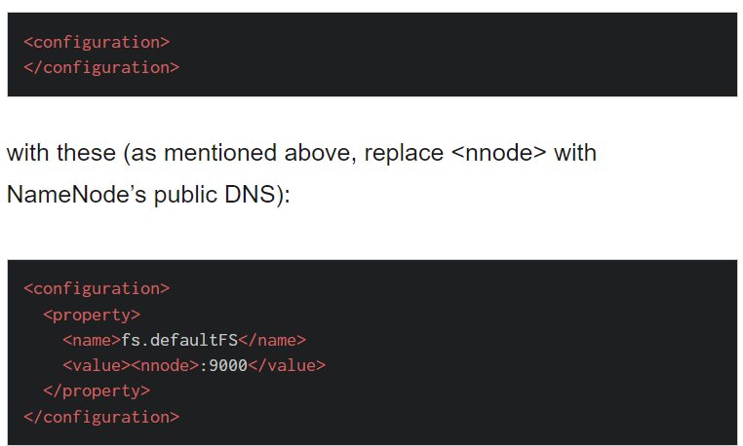
All Nodes: Update core_site.xml
On each node, edit ~/server/hadoop-2.7.3/etc/hadoop/core-site.xml
and replace the following lines:

Slide 24

All Nodes: Create Data Dir
HDFS needs the data directory to be present on each node: 1 name node and 3 data nodes. Create this directory as shown and change ownership to user ubuntu.
Configuring NameNode
After performing configuration common to all nodes, let us now setup the NameNode.
Namenode: Password Less SSH
As mentioned before, we need password-less SSH between the name nodes and the data nodes. Let us create a public-private key pair for this purpose on the namenode.
Use the default (/home/ubuntu/.ssh/id_rsa) for the key location and hit enter for an empty passphrase.

Slide 25

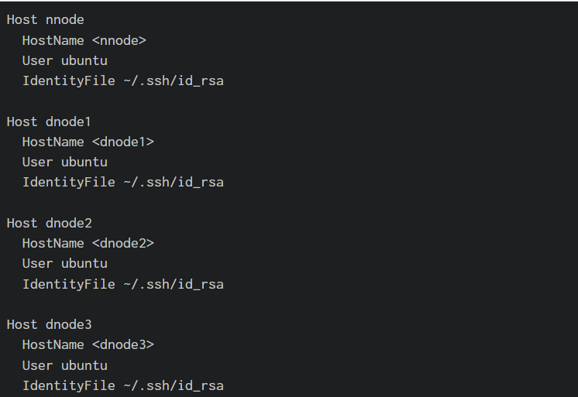
Datanodes: Setup Public Key
The public key is saved in /home/ubuntu/.ssh/id_rsa.pub . We need to copy this file from the namenode to each data node and append the contents to
/home/ubuntu/.ssh/authorized_keys on each data node.
Namenode: Setup SSH Config
SSH uses a configuration file located a ~/.ssh/config for various parameters. Set it up as shown below. Again, substitute each node’s Public DNS for the HostName parameter (for example, replace <nnode> with EC2 Public DNS for NameNode).

Slide 26

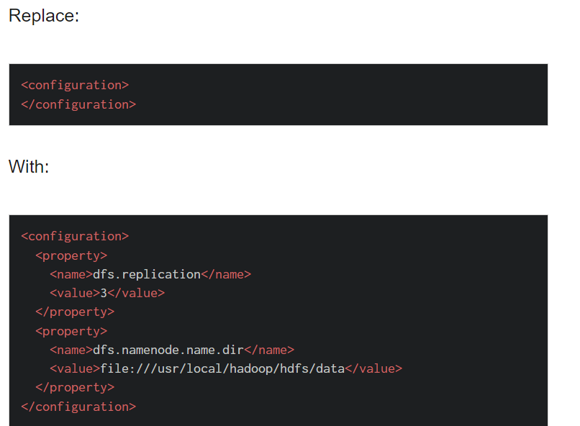
At this point, verify that password-less operation works on each node as follows (the first time, you will get a warning that the host is unknown and whether you want to connect to it. Type yes and hit enter. This step is needed once only):
Namenode: Setup HDFS Properties
On the NameNode, edit the following file:
~/server/hadoop-2.7.3/etc/hadoop/hdfs-site.xml

Slide 27
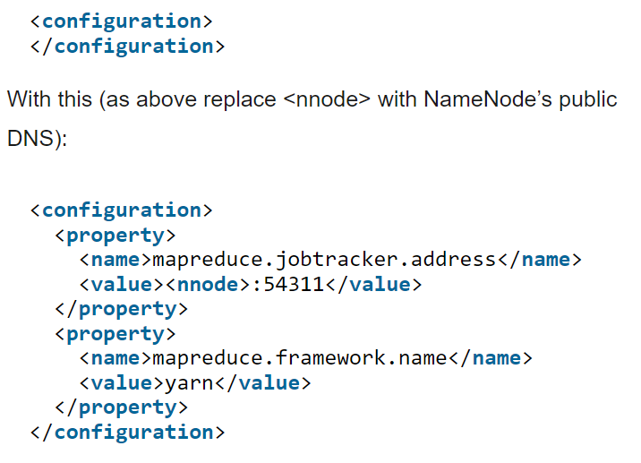
Namenode: Setup MapReduce Properties
On the NameNode, copy the file (~/server/hadoop-2.7.3/etc/hadoop/mapred-site.xml.template) to
(~/server/hadoop-2.7.3/etc/hadoop/mapred-site.xml)
Replace:

Slide 28
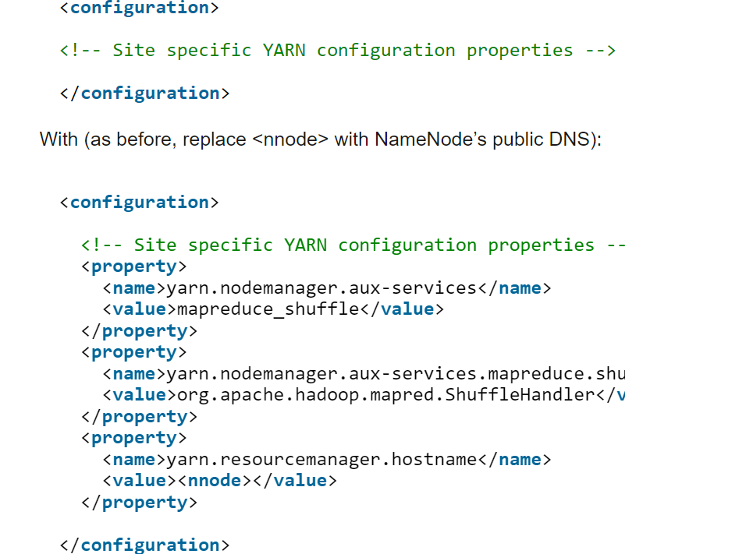
Namenode: Setup YARN Properties
Next we need to set up ~/server/hadoop-2.7.3/etc/hadoop/yarn-site.xml on the NameNode.
Replace the following:

Slide 29
Namenode: Setup Master and Slaves
On the NameNode, create ~/server/hadoop-2.7.3/etc/hadoop/masters with the following (replace <nnode> with the NameNode’s public DNS):
<nnode>
Also replace all content in ~/server/hadoop-2.7.3/etc/hadoop/slaves with (replace each of <dnode1>, etc with the appropriate DateNode’s public DNS):
<dnode1>
<dnode2>
<dnode3>

